Slide 1

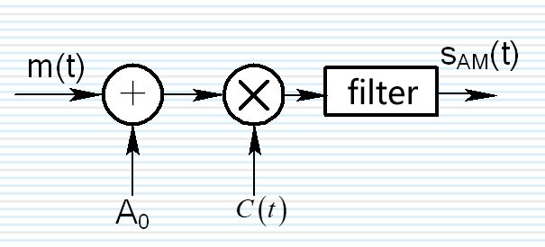
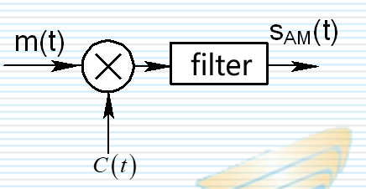
AM modulation and demodulation
1、Purpose of the experiment ：
Understand and master the principle of AM modulation.
2、Experimental content：
Set the modulating signal to ym = Am*sin(2*pi*fa*t); The carrier signal is Ac*sin(2*pi*fc*t)，Find the time domain waveform and spectrum of AM signal and carrier signal。
3、Experimental principle：
Using the principle of modulation and demodulation, Butterworth low-pass filter
Notes:
一、实验目的 ：
理解并掌握AM调制的原理。
二、实验内容：
设调制信号为ym = Am*sin(2*pi*fa*t);载波信号为Ac*sin(2*pi*fc*t)，求AM信号、载波信号的时域波形和频谱。
三、实验原理：
利用调制解调原理、巴特沃斯低通滤波器

Slide 2
4、Experimental organization operation requirements
This experiment adopts the form of centralized teaching, and each student completes the above experimental requirements independently.
5、Experimental condition
Each person has one computer to complete the experiment independently, with the following conditions:
（1）Hardware: microcomputer；
（2）Software: MATLAB.
6、Experimental procedure
（1）Complete the writing of each function;
（2）Call each function in the main function to realize the spectrum analysis of the signal.
7、Experimental report
The experimental report mainly includes the experimental purpose, experimental content, experimental principle, source program and results.
Notes:
四、实验组织运行要求
本实验采用集中授课形式，每个同学独立完成上述实验要求。
五、实验条件
每人一台计算机独立完成实验，有如下条件：
（1）硬件：微机；
（2）软件：MATLAB。
六、实验步骤
（1）将各函数编写完成；
（2）在主函数中调用各函数，实现信号的频谱分析。
七、实验报告
实验报告主要包括实验目的、实验内容、实验原理、源程序及结果。

